Slide 1
DYNAMIC MULTI-SENSOR TELEMETRY & MEASUREMENT ANALYSIS ON VEHICLES
Final Presentation - Fall 2025
ME 372C Theory and Design for Mechanical Sensing and Measurement
Dr. Wei Li
Quinn Farquharson, Josh Haase, Dylan Hammerbeck, Ethan Salazar

Slide 2
CONTEXT AND PRIOR WORK
Telemetry is a cornerstone of motorsports, robotics, and vehicle dynamics engineering
Professional systems combine IMU, GNSS, and thermal sensing to understand acceleration, handling, and component load
Research-grade loggers enable event detection (braking, cornering), performance tuning, and fault diagnosis
Our project recreates these capabilities using a compact, low-cost platform suitable for academic experimentation
Notes:
Ethan

Slide 3
PROJECT OBJECTIVES
Build & calibrate multi-sensor measurement system
Acquire synchronized IMU, GNSS, and thermal data at 20 Hz
Perform structured dynamic tests (Accel/Coast/Brake, Coastdown, CW/CCW Circles)
Apply measurement theory: dynamic characteristics, uncertainty, filtering
Perform system identification & classification
Evaluate performance and limitations
Notes:
Ethan

Slide 4
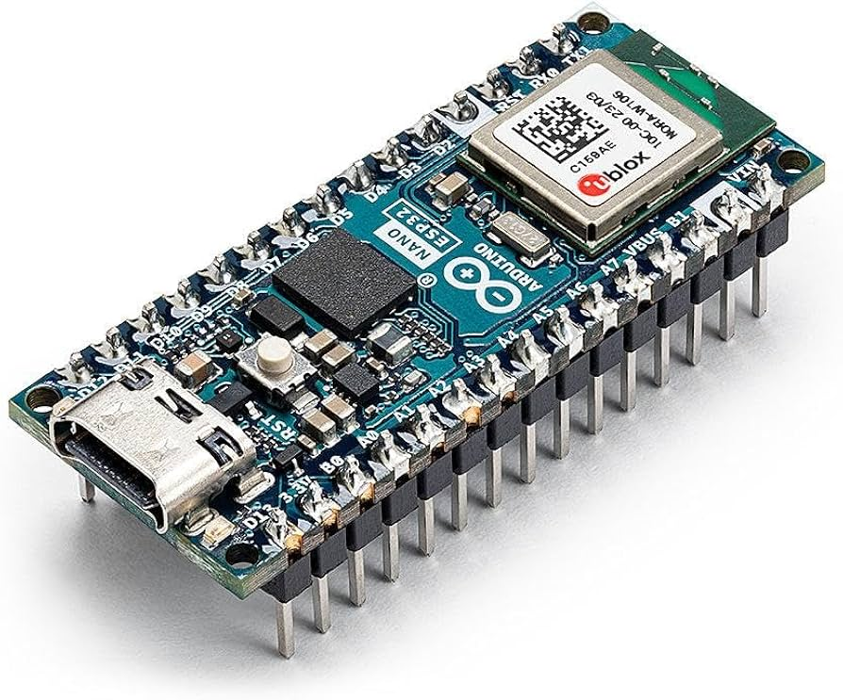
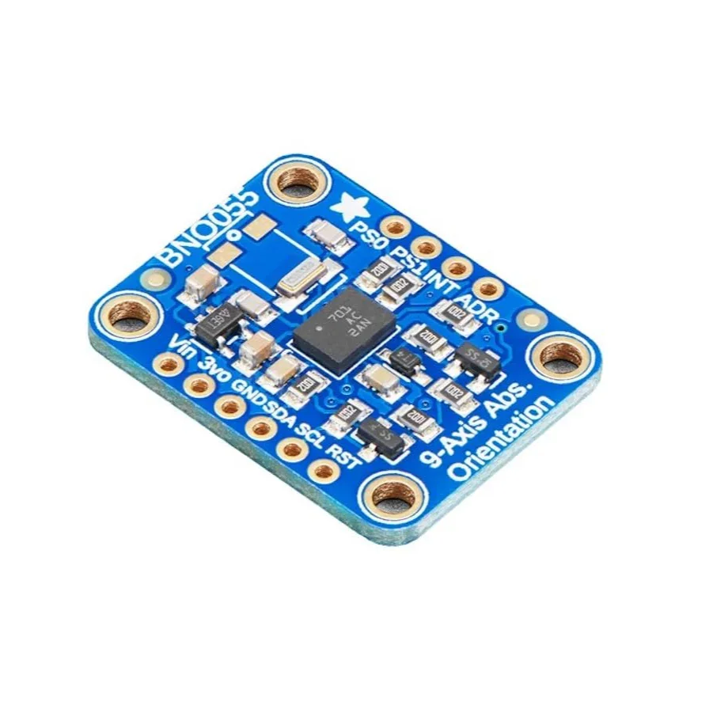
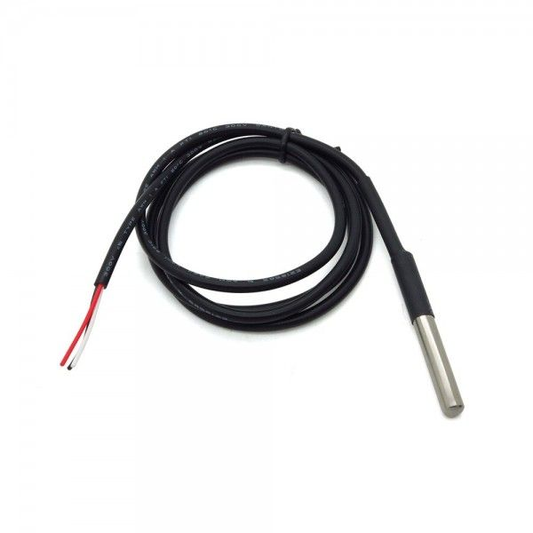
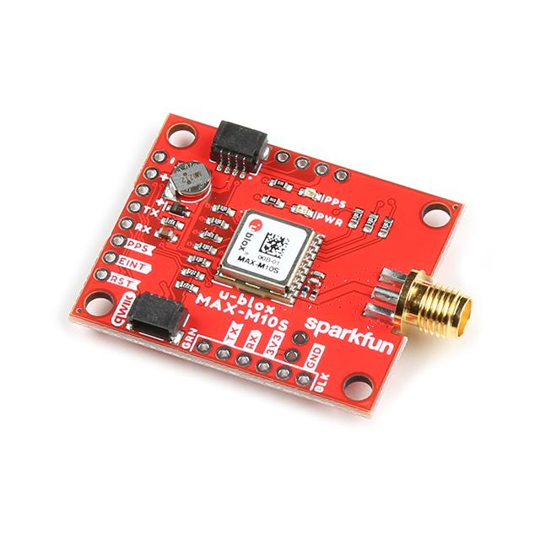
MEASUREMENT SYSTEM OVERVIEW
Sensors:
BNO055 IMU
u-blox MAX-M10S GNSS
4× DS18B20 Temp
GPS Antenna + Qwiic I²C interconnect
Arduino Nano
ESP32
CSV Log
Python Analysis
Multi-sensor telemetry platform built on Arduino Nano ESP32
IMU + GNSS + thermal sensing integrated via I²C and OneWire
20 Hz fused logging → high-resolution maneuver detection
Data exported as CSV for Python analysis
Notes:
Ethan

Slide 5
STATIC & DYNAMIC CHARACTERISTICS OF OUR SENSORS
Sensor | Key Static Characteristics | Key Dynamic Characteristics
BNO055 IMU | • ±2–3° absolute orientation accuracy (post-calibration) • Accelerometer ±16 g, gyro ±2000 °/s • 0.06 °/s gyro resolution | • 100 Hz fused output (≈10 ms latency) • Good short-term stability; small gyro drift with temperature • Handles typical vehicle maneuvers cleanly
u-blox MAX-M10S GNSS | • ~2 m CEP horizontal accuracy (open sky) • Speed accuracy ±0.05 m/s | • 1–10 Hz update rate (we use 10 Hz) • Meter-level jitter in position; stable velocity • ~0.1–0.2 s effective latency
DS18B20 Temp Sensors | • ±0.5 °C typical accuracy (−10 → 85 °C) • 0.0625 °C resolution | • 1 Hz sampling • Slow thermal response (first-order lag) • Ideal for gradual tire/engine temperature trends
Notes:
Josh

Slide 6
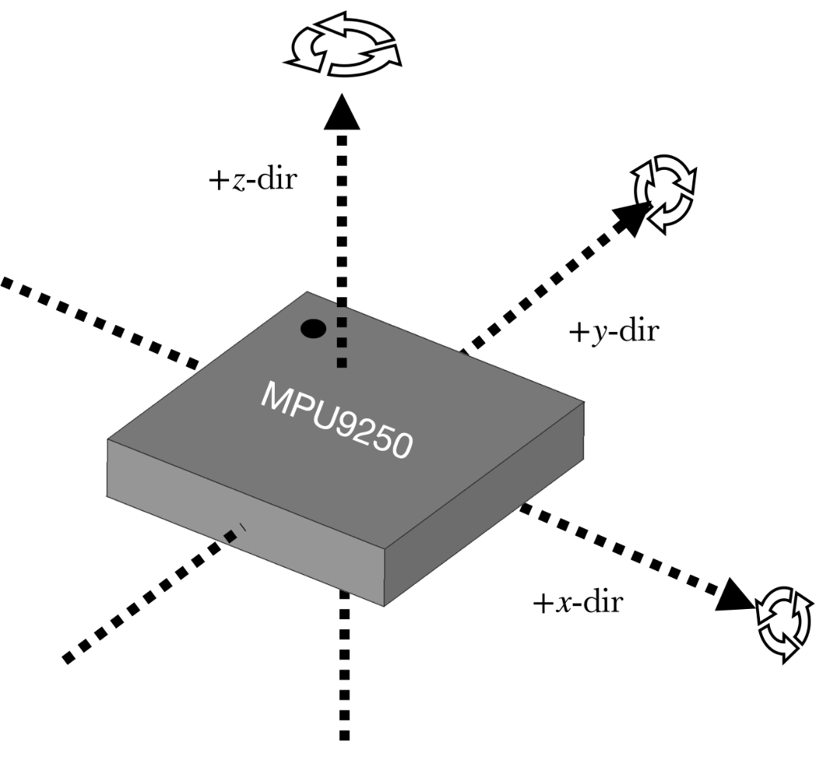
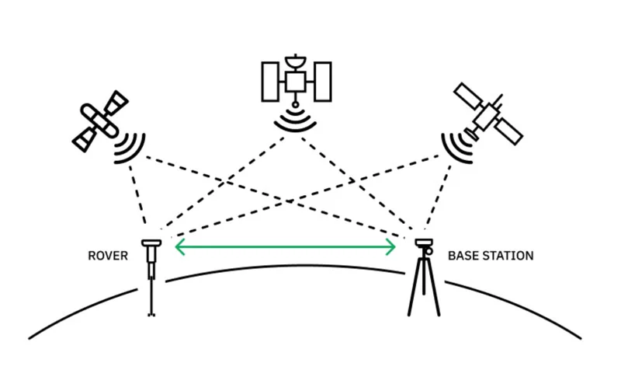
CALIBRATION PROCEDURES
IMU (BNO055) calibration
Ran dedicated Arduino calibration script to monitor sys/gyro/accel/mag status
Performed standard motion routine (slow rotations about each axis, figure-8s) until all calib flags = 3
Read out and saved hard-iron/soft-iron offsets from getSensorOffsets() and hard-coded them into the logging sketch
GNSS (MAX-M10S) validity checks
Waited for GNSS to reach a 3D fix (fix = 3) before starting each run.
Ignored data during warm-up period / satellite acquisition
Temperature sensors (DS18B20) verification
Allowed all four probes to stabilize at ambient before testing.
Confirmed readings were within ~0.5 °C of each other and ambient → treated this as zero-offset check
Notes:
Ethan

Slide 7
STRUCTURED TESTING MATRIX
Test Type | Purpose in Analysis
Clockwise Circles (Skidpad 1) | Characterize steady-state turning and yaw rate
Counter-Clockwise Circles (Skidpad 2) | Characterize steady-state turning and yaw rate and check turning symmetry
Acceleration–Coast–Brake (Straight line) | Separate accel/coast/brake phases and tune event thresholds
Driving w/ all Dynamic States | Validate the system classification, gnss, and imu sensors
Notes:
Dylan

Slide 8
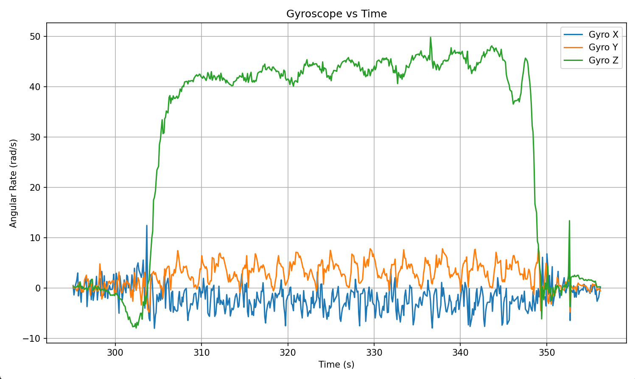
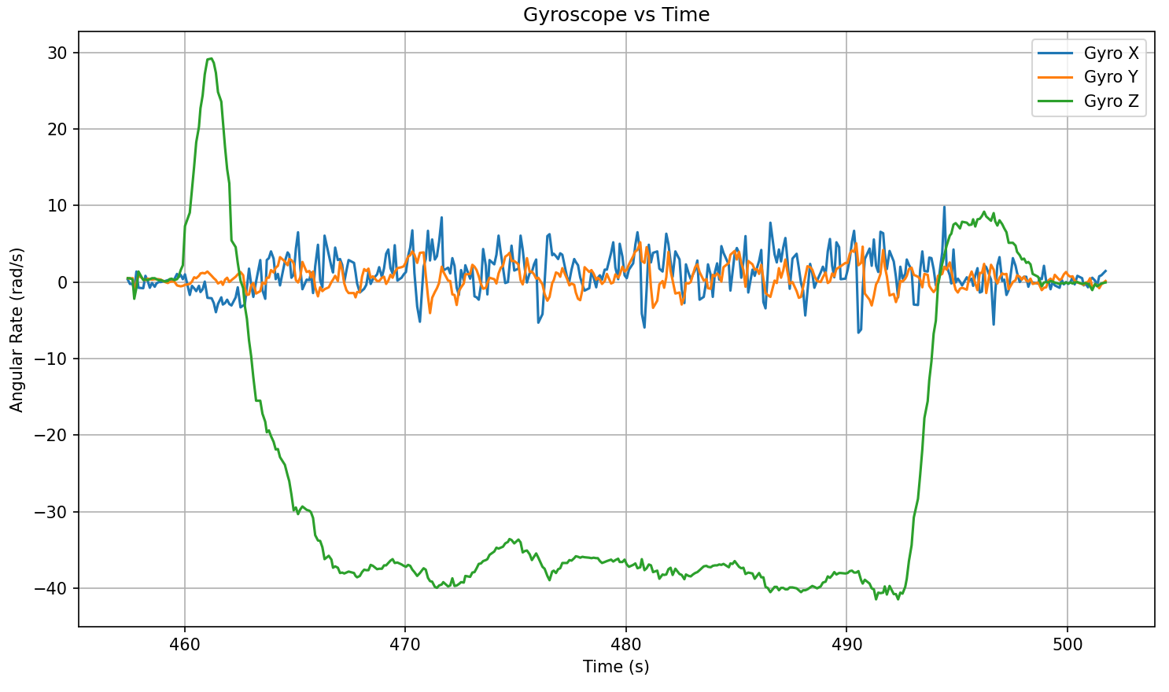
HOW DATA WAS PROCESSED
GPS data from the GNSS sensor was shaky and inaccurate due to jitter and the limited connection to satellites
Much of the data we collected from the IMU was very noisy and could lead to incorrect data interpretation
As such we moved forward with some basic data processing to help eliminate any error caused by the noise within our system and data stream
Notes:
Quinn

Slide 9
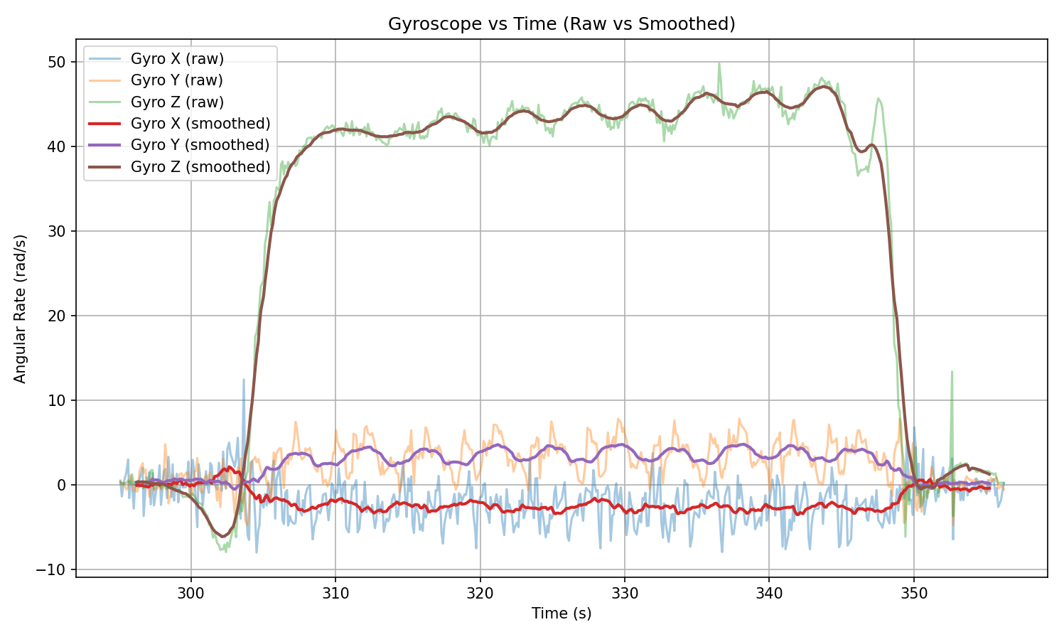
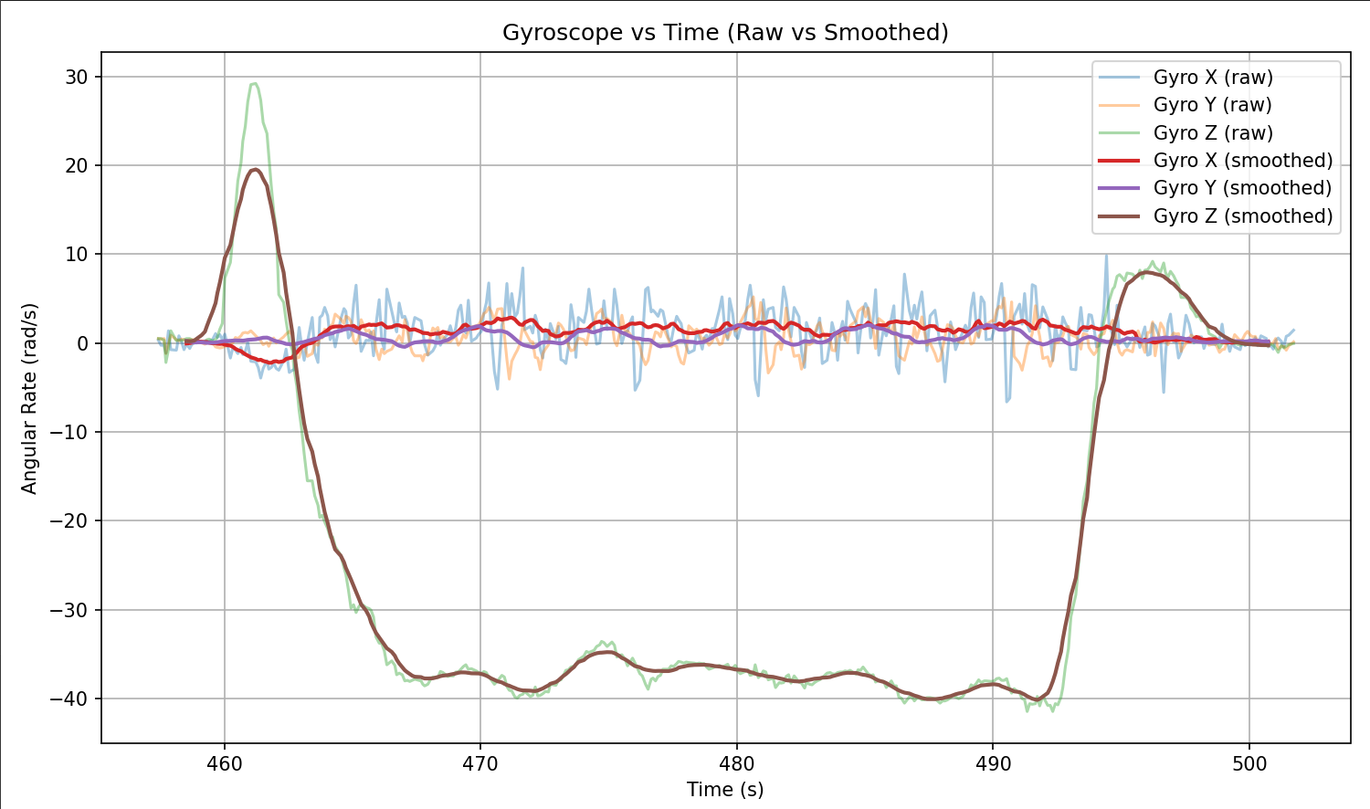
HOW DATA WAS PROCESSED
Rolling Average smoothing filter (window size of 20) allows larger trends in data to be reflected without larger noise variance
Additionally the large delta in one axis allows us to predict turns very accurately
Left image is a counter clockwise turn, right image is a clockwise turn
Notes:
Quinn

Slide 10
DATASETS AND CHANGE OF TEST PLATFORM
Initial tests were performed on the go-kart with IMU, GNSS, and 4× temperature probes
Clearly displayed tire/engine temperatures and GNSS skidpad estimates for circles
To obtain high-quality accel and gyro data for event classification, we re-mounted the same IMU + GNSS stack in a Tesla and repeated the maneuvers (no temperature probes on this platform)
Go kart limited data required due to stiff chassis (less pitch, roll, and yaw data from gyro) and less similar to FSAE
In the results:
Kart data is used to demonstrate thermal sensor performance and validate GNSS-based path geometry
Tesla data is used for dynamic analysis and event classification (acceleration, braking, turning)
Main limitation: current classifier uses kinematics only; integrating tire temps into the Tesla setup the next step
Notes:
Dylan

Slide 11
PLATFORM & DATASET SUMMARY
Platform | Sensors Used | Purpose in Project
Go-kart (outdoor lot) | IMU (Euler only), GNSS, 4× tire/engine temps | Demonstrate tire/engine thermal behavior and validate GNSS-based path geometry (circle radius + turning direction)
Tesla (road tests) | IMU (accel + gyro + Euler), GNSS | Collect clean dynamic data for acceleration, braking, and turning classification (no temps)
Together, the go-kart and Tesla datasets demonstrate that all parts of our telemetry stack work as intended: thermal sensing, GNSS-based path estimation, and IMU-based dynamics. The same architecture could be deployed on a single vehicle in future tests to capture the full feature set simultaneously and support richer event classification.
Notes:
Quinn

Slide 12
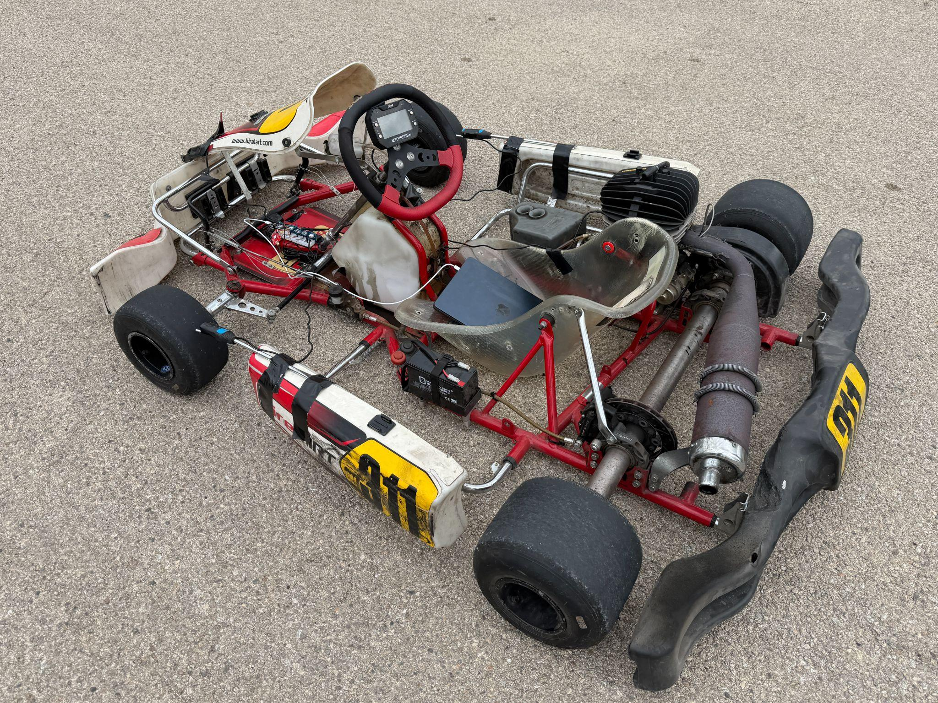
KART SENSOR POSITIONING
Temperature sensors
IMU & GNSS
Notes:
Dylan

Slide 13
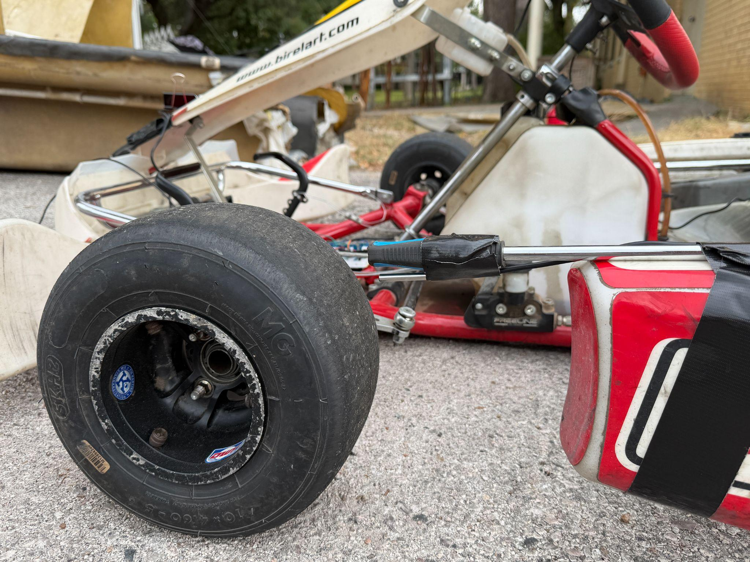
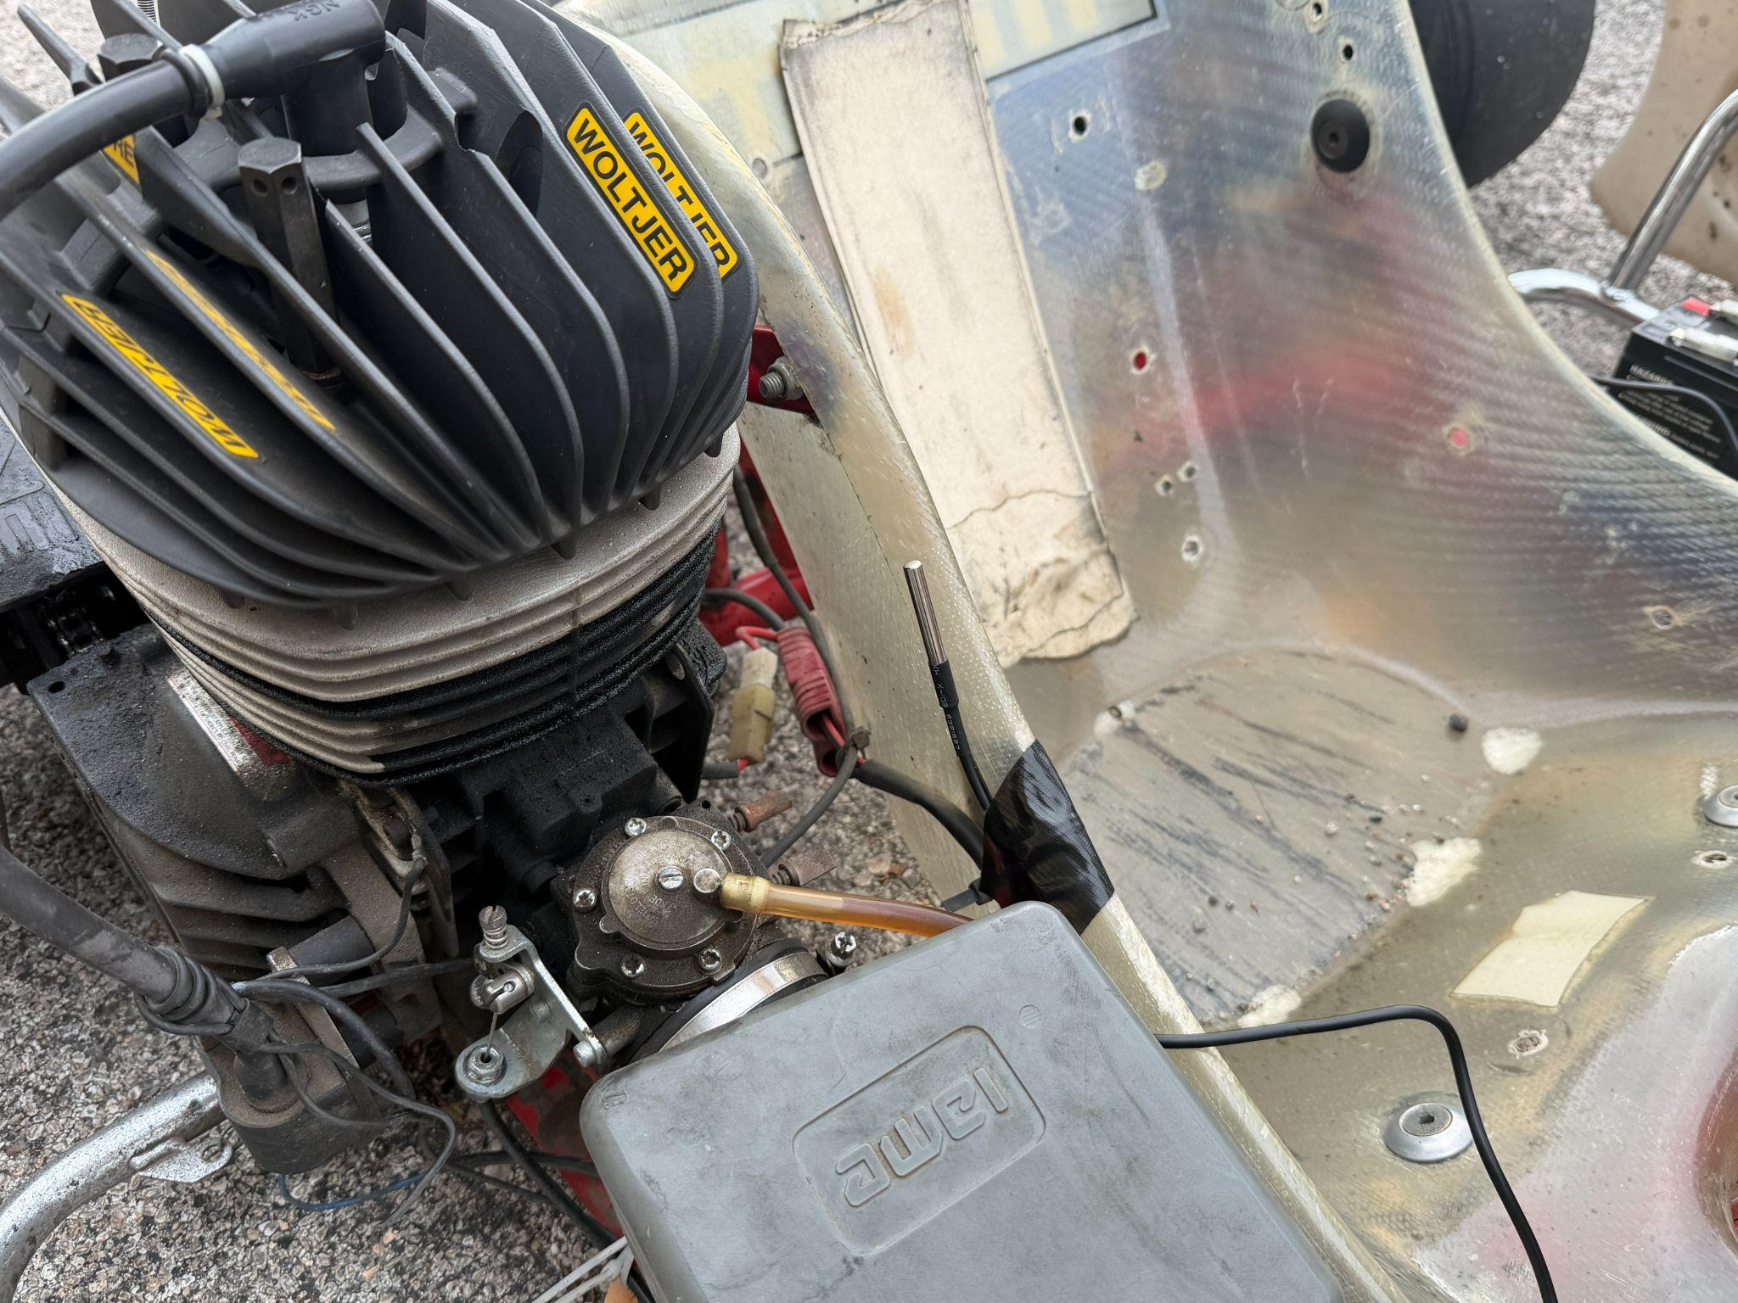
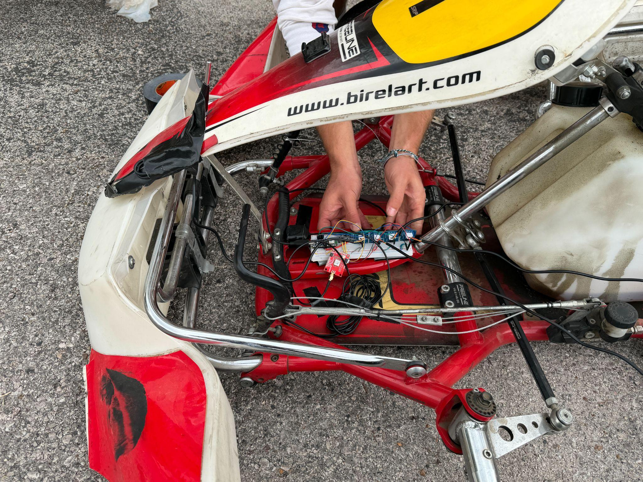
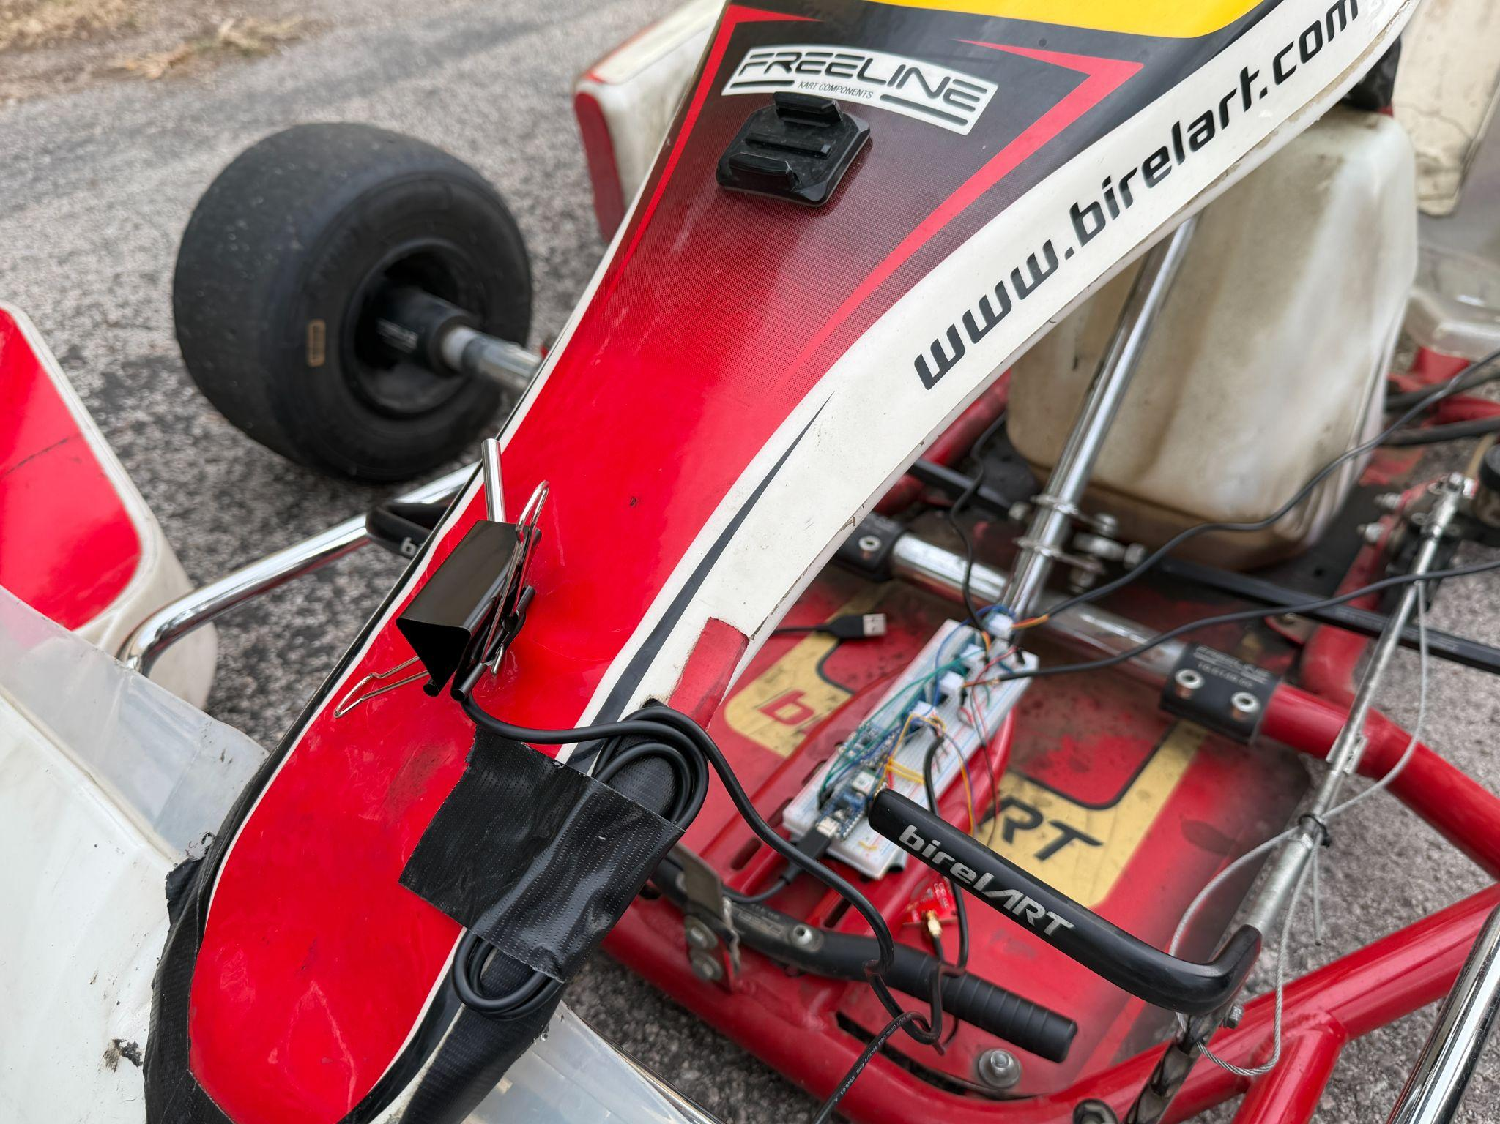
Notes:
Dylan

Slide 14
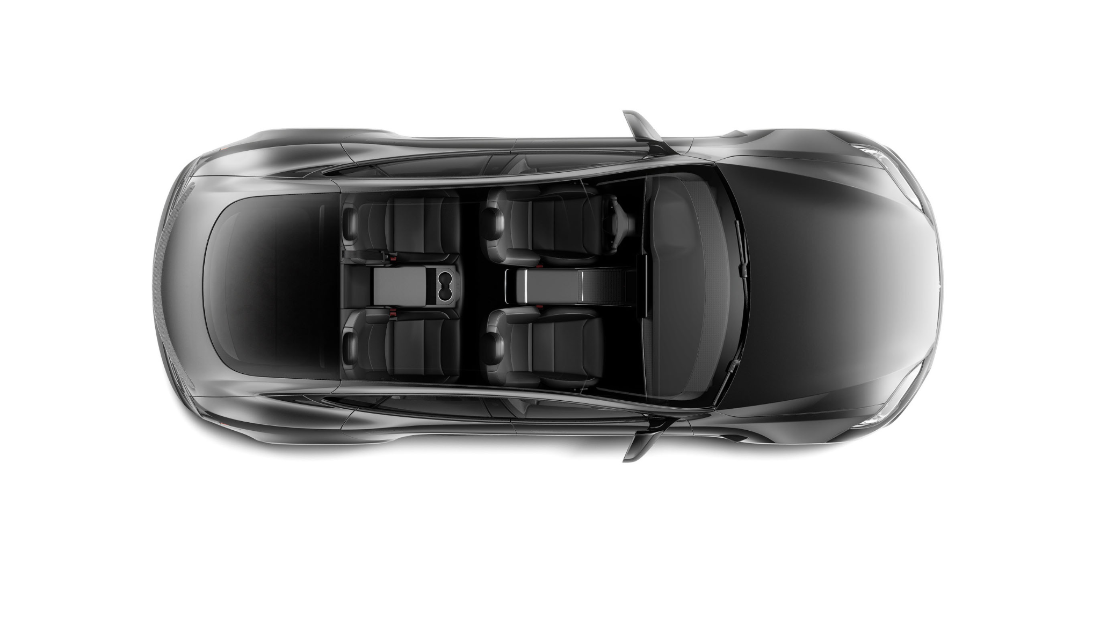
TESLA SENSOR POSITIONING
IMU
GNSS
Notes:
Dylan

Slide 15
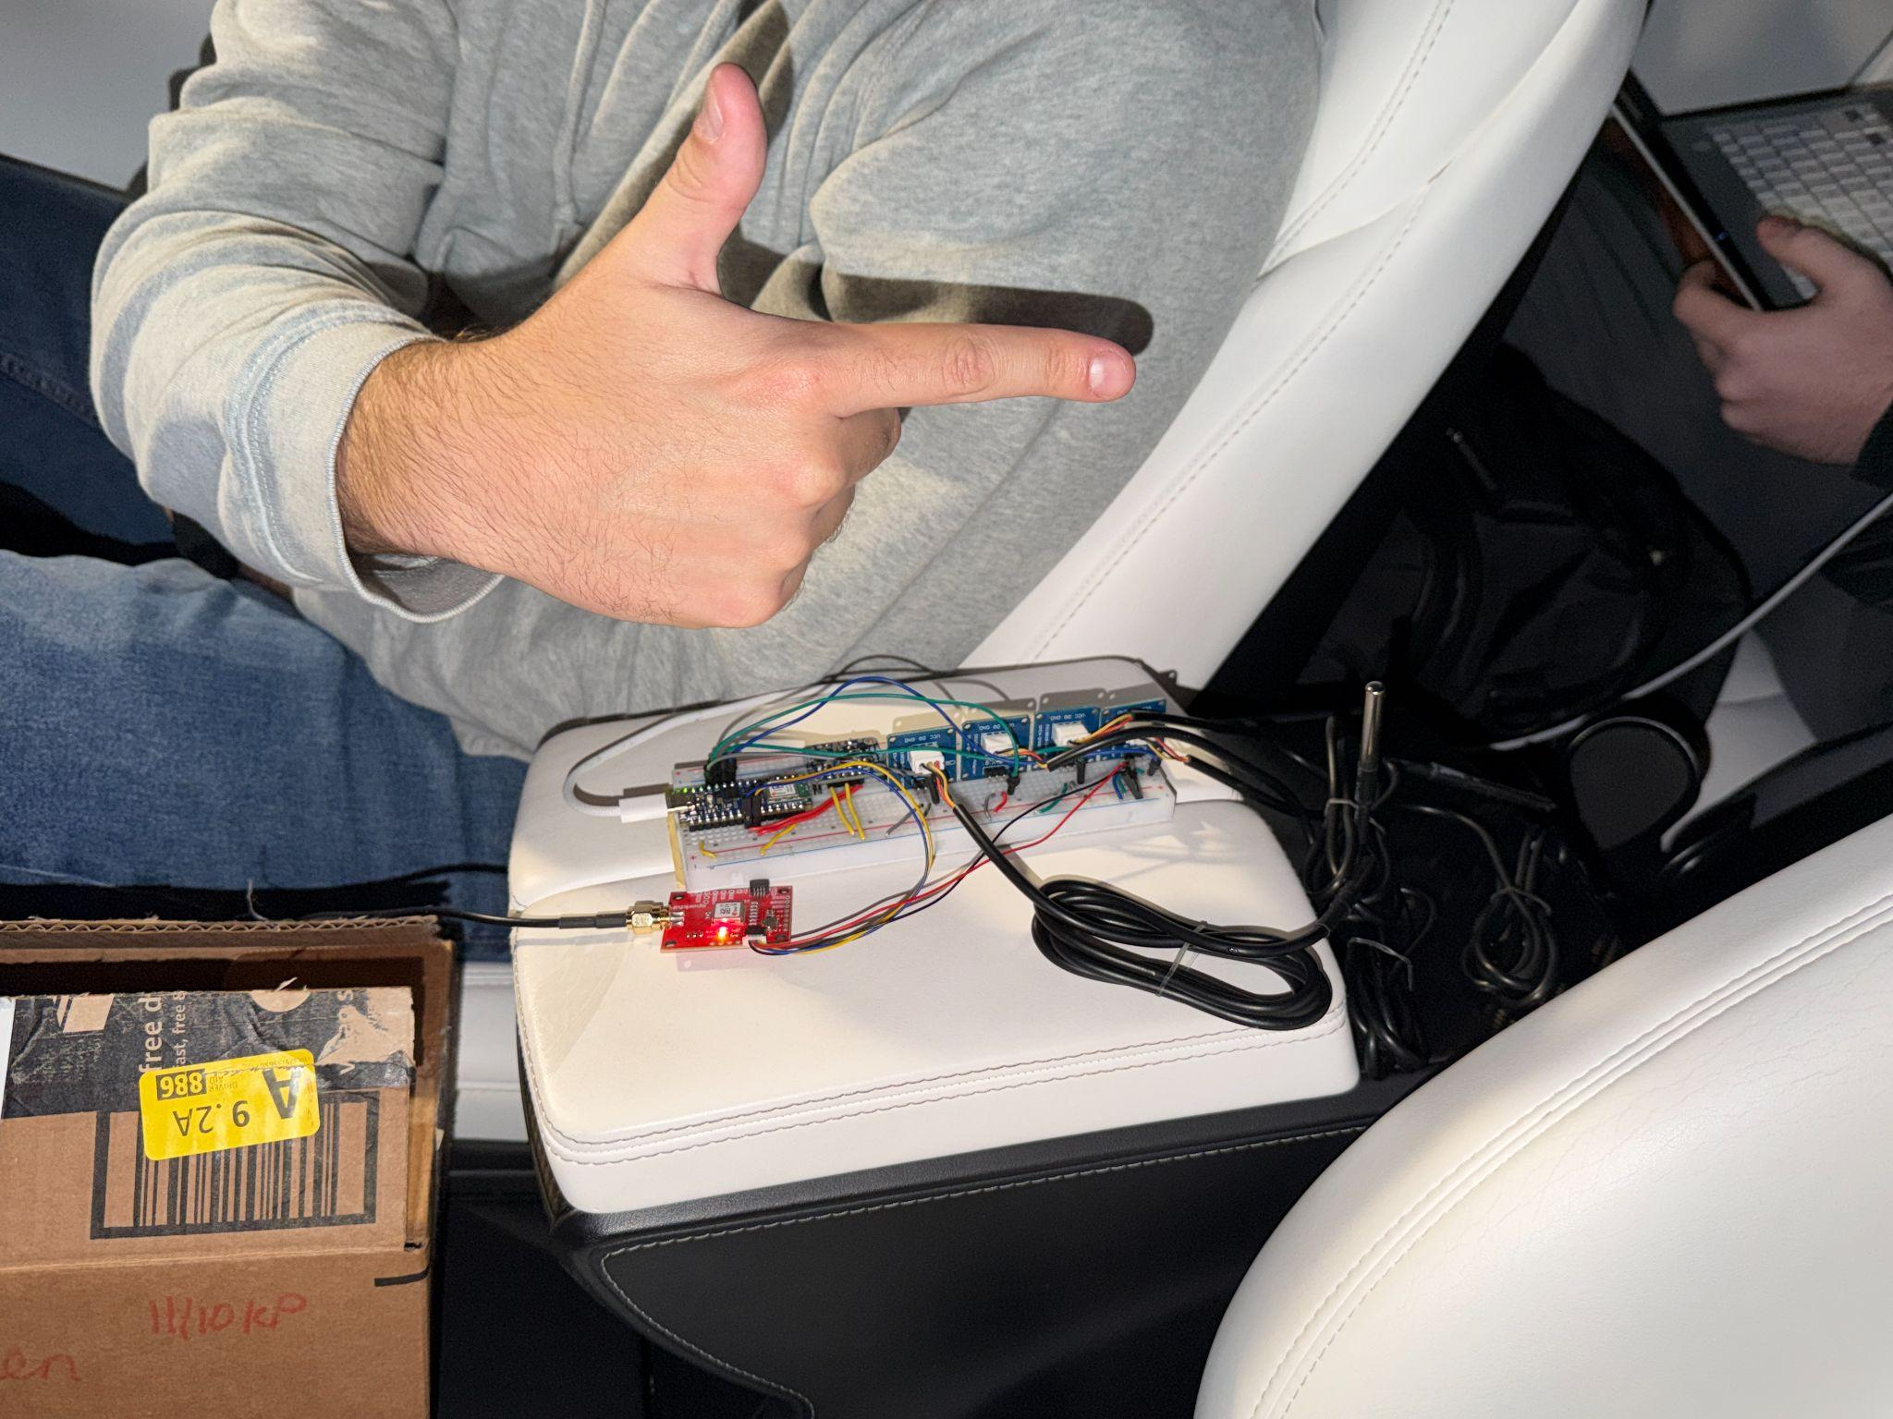
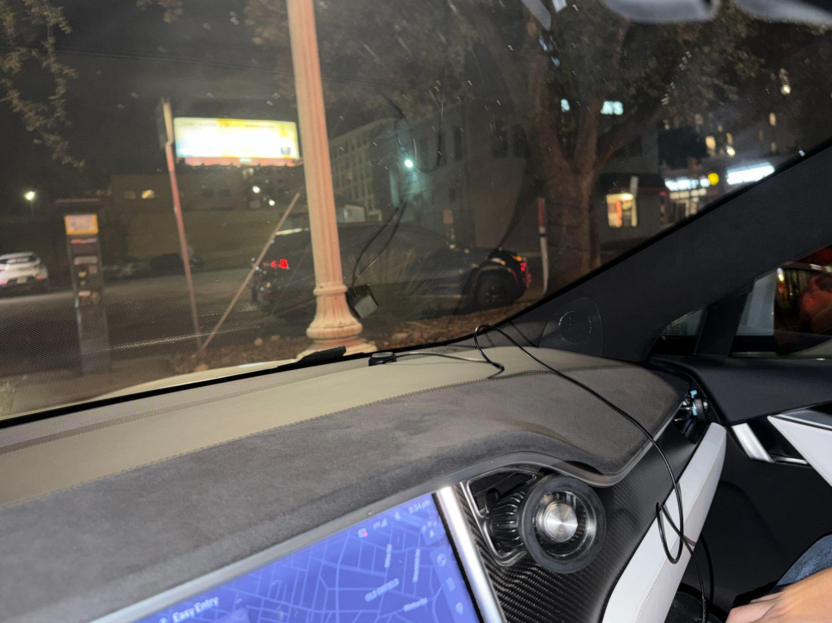
Notes:
Dylan

Slide 16
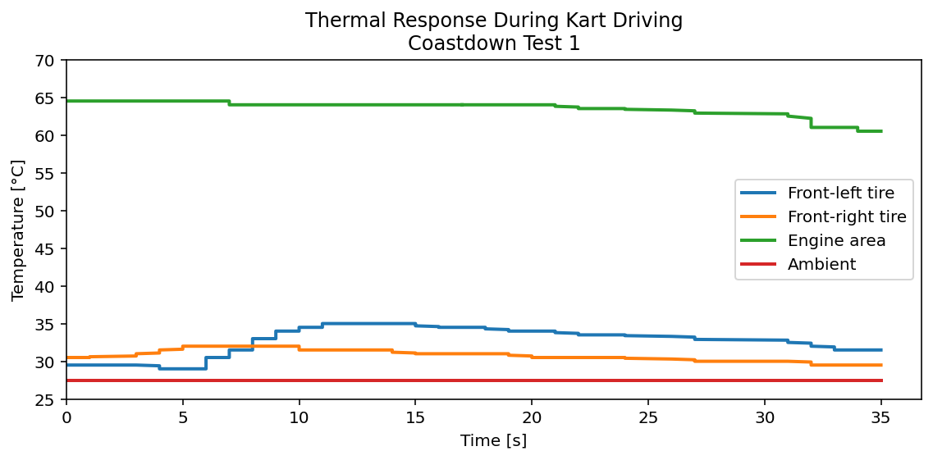
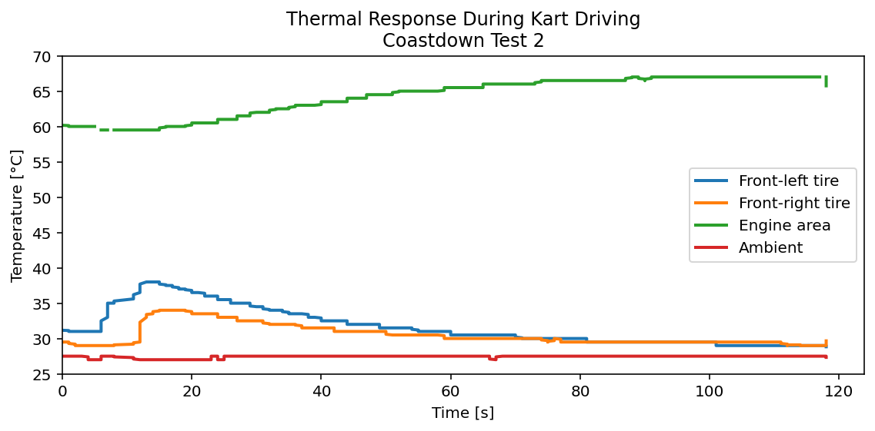
STRAIGHT-LINE THERMAL RESPONSE: COASTDOWN TESTS
During acceleration + coastdown, front tires heat up by 5-8 °C over 10-20 s, then slowly cool as load is removed.
Engine temperature acts like a large thermal mass:
Test 1 → slowly decays from a hot starting point
Test 2 → ramps steadily from ~60 °C to ~67 °C during repeated runs
Ambient trace is flat → confirms sensors are measuring true component heating, not environmental drift
These runs illustrate first-order-like heating and cooling transients in the tires and motor
Notes:
Ethan

Slide 17
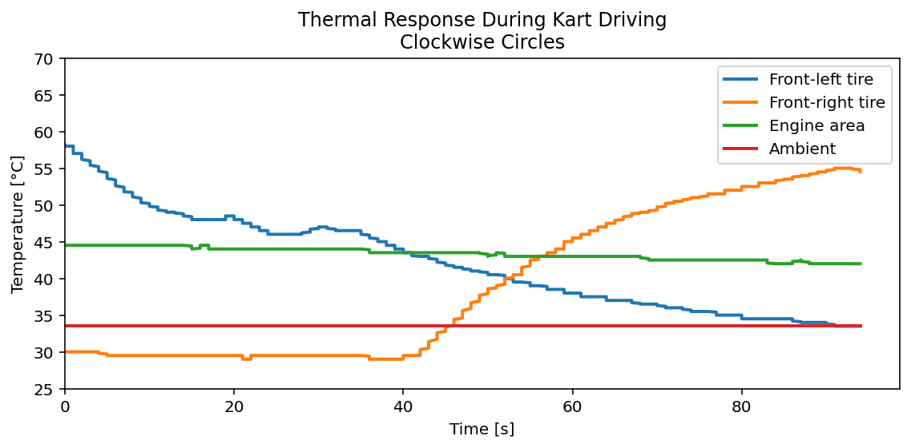
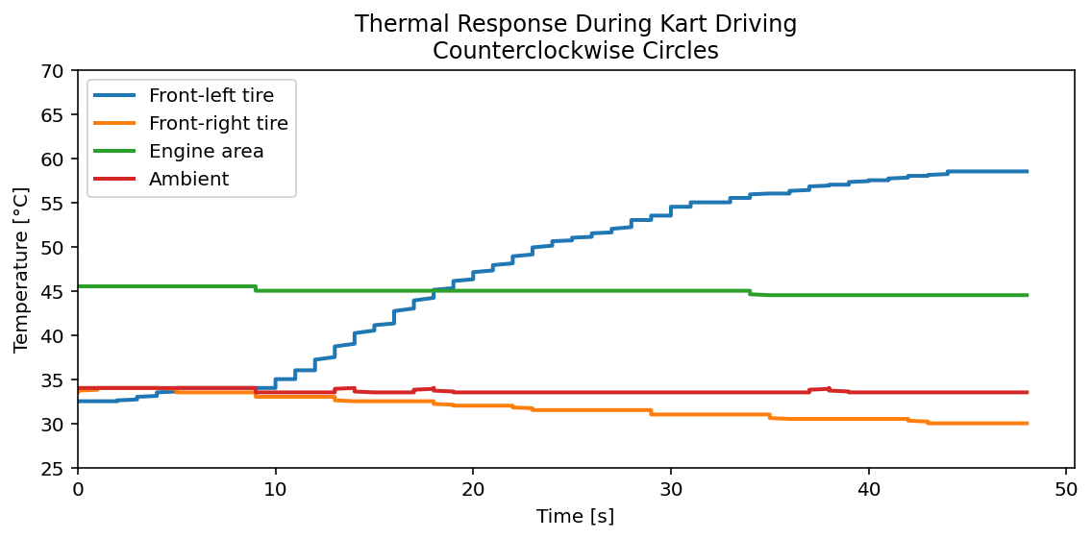
DIRECTIONAL TIRE HEATING IN CIRCULAR DRIVING
Clockwise circles:
Front-right (outside) tire heats from ~30 °C → ~55 °C
Front-left (inside) tire cools from ~58 °C toward mid-30s as load shifts off it
Counterclockwise circles:
Behavior flips: front-left (outside) tire heats from low-30s → ~59 °C, while front-right drifts slightly down
Engine and ambient traces remain relatively flat in both cases, isolating the effect to lateral load transfer
Together, these runs show the temperature sensors are sensitive enough to capture direction-dependent tire loading, not just overall vehicle warm-up
Notes:
Josh

Slide 18
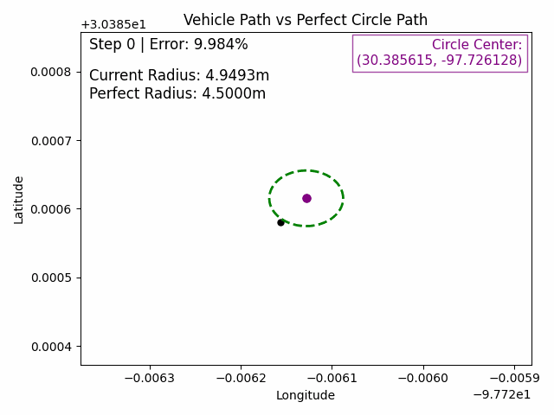
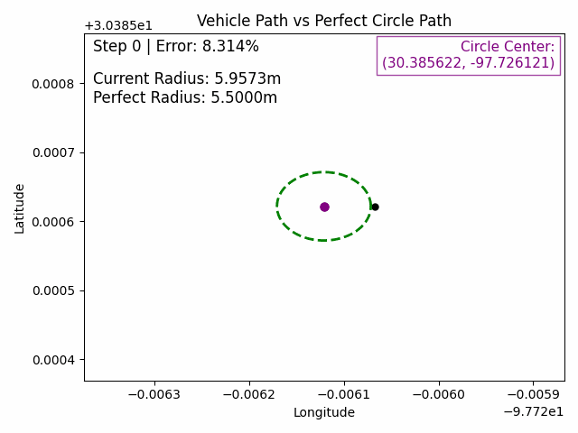
RADIUS, PATH CONSISTENCY, & TURNING DIRECTION DETECTION
GNSS x–y path for clockwise and counterclockwise kart circles, overlaid with a perfect circle
Fitted radii stay within ≈5–15% of the target (4.5 m / 5.5 m), showing good path consistency
GIFs show error and deviation from pre-programmed path, with could be used for more complex pathing in future
applications
Confirms that even with low-cost GNSS, we can estimate turning radius and direction from our telemetry stack
Notes:
Josh

Slide 19

GNSS PATH RECONSTRUCTION
Notes:
Josh

Slide 20
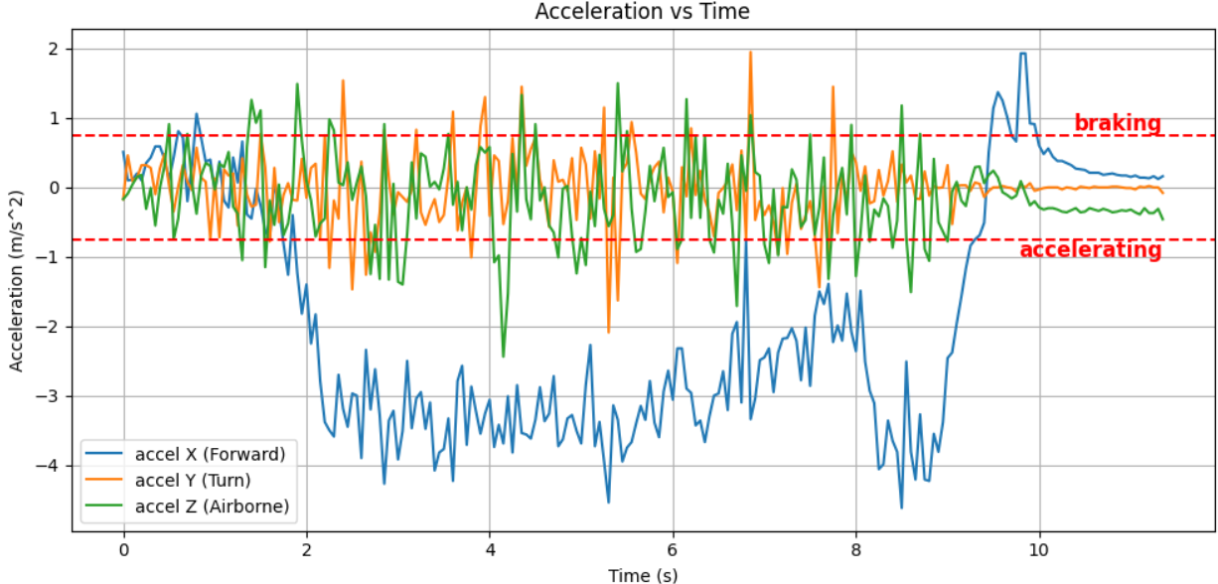
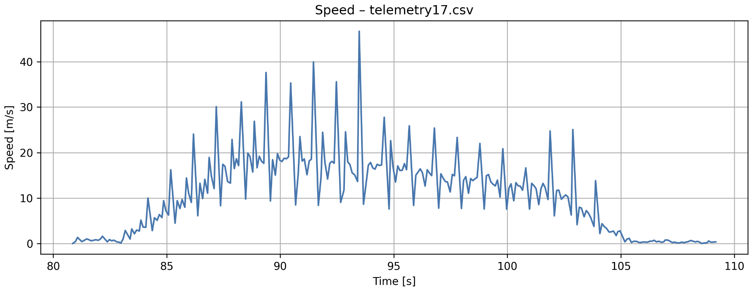
DYNAMIC RESPONSE: ACCELERATION, COASTING, BRAKING RESULTS
Plot: speed(t) + accel(t) with color-coded regions
Clear segmentation of driving phases
Observed acceleration values
Observed braking deceleration
Notes:
Dylan

Slide 21
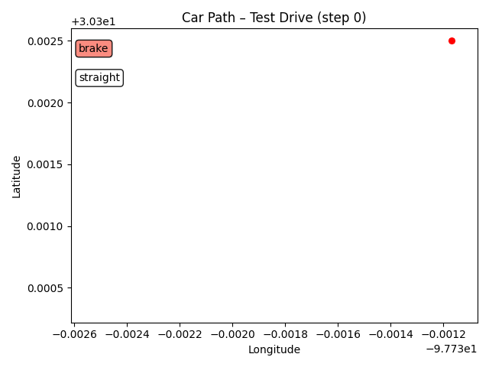
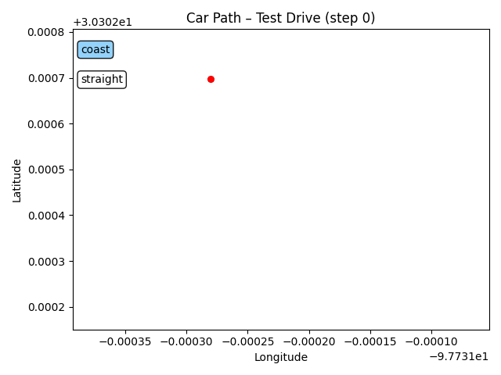
SYSTEM CLASSIFICATION FROM DYNAMIC TESTS
Utilized rule based system classification with filters
Two type of classification
Straight line to classify accel, coast, and braking events
Turning to classify left, straight, and right turn events
Related X Accel to straight line events
Related Z Gyro to turning events
Will look to implement more robust system with decision theory
Notes:
Dylan

Slide 22
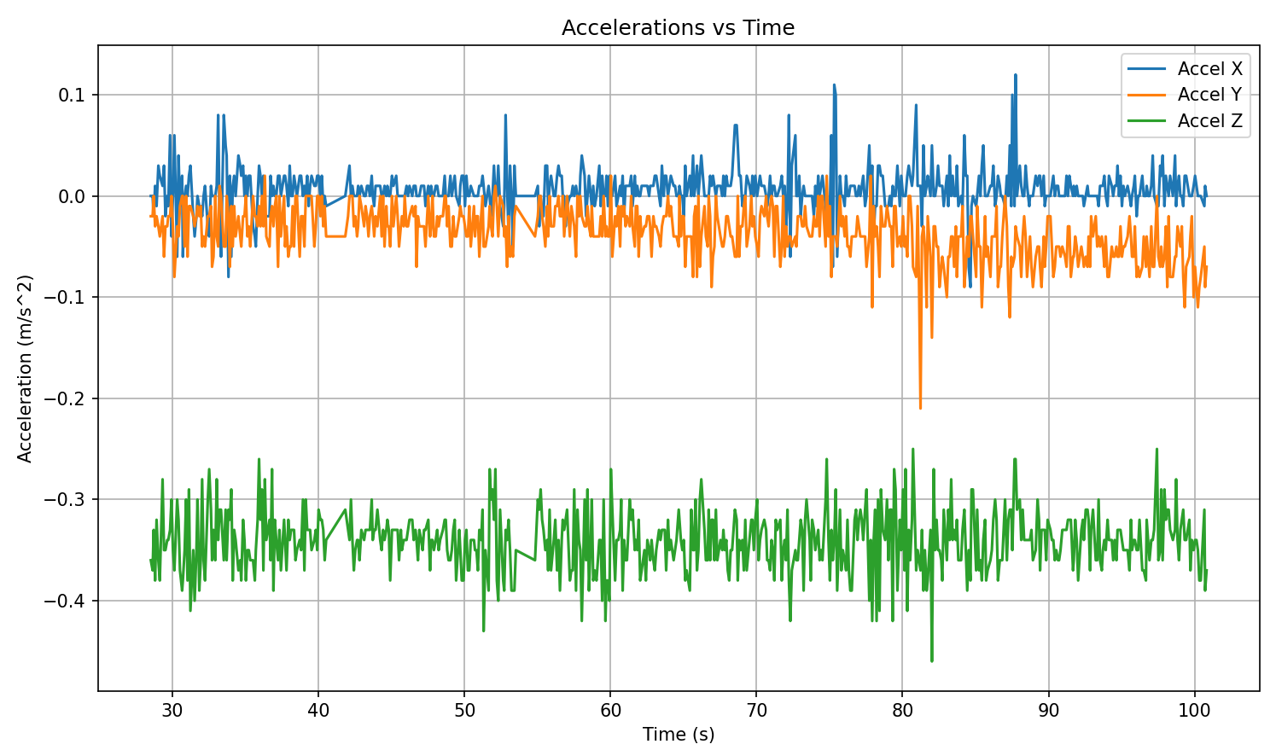
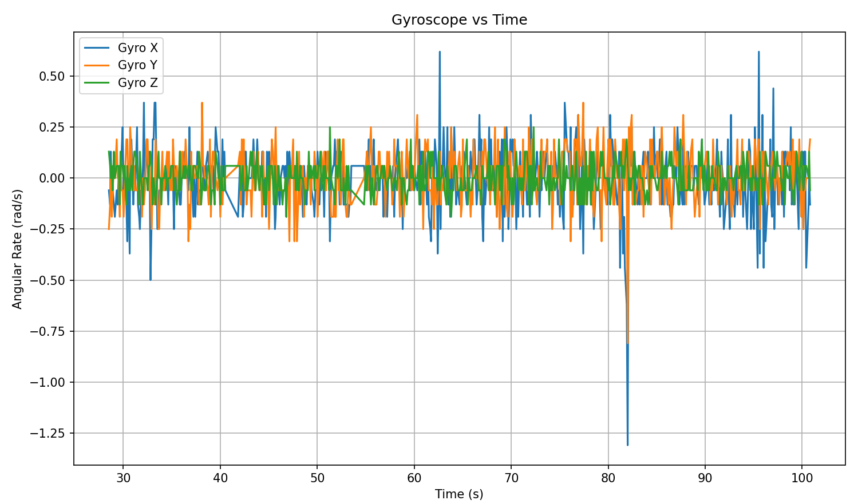
UNDERSTANDING LIMITATIONS
From the IMU Spec Sheet
2 degree Alignment error in Accelerometer data
0.03%/K thermal drift
±80 mg Zero-g Offset
±0.2% FS Nonlinearity in Gyro
±1 /s Zero - Rate Offset
13/13/15 bits X/Y/Z Resolution
Notes:
Josh

Slide 23
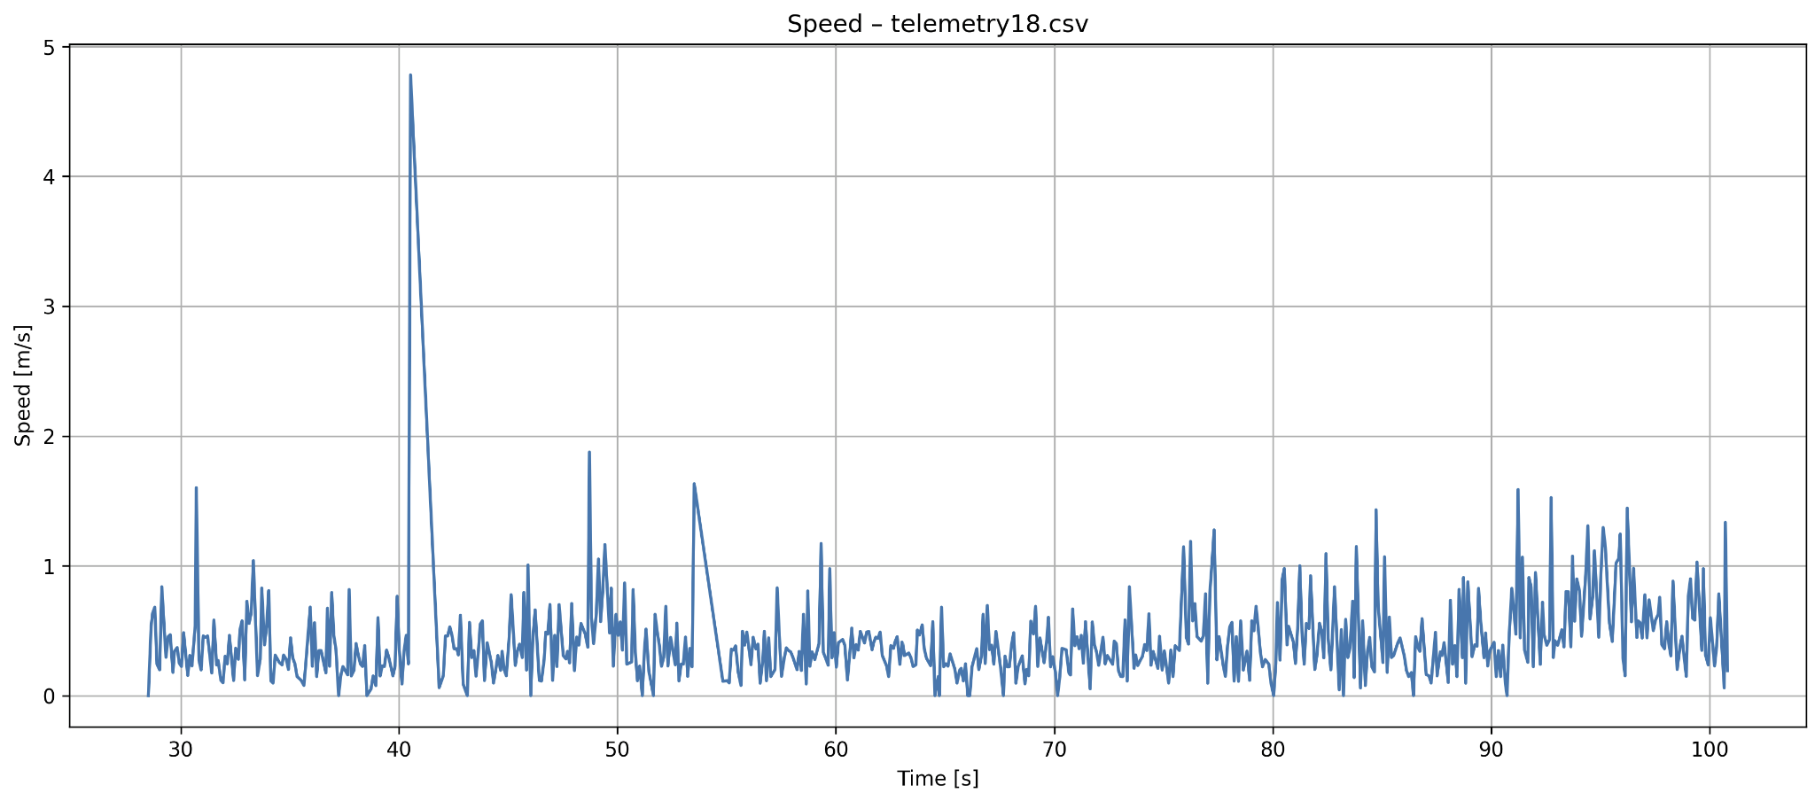
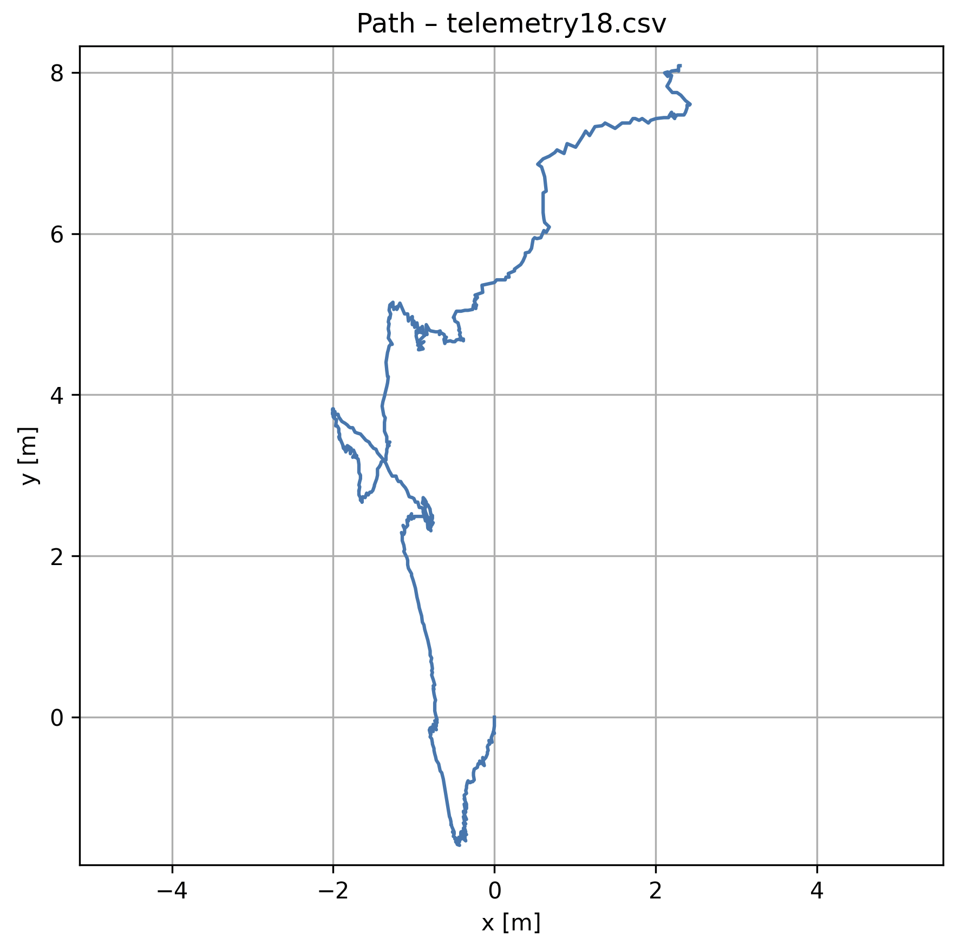
UNDERSTANDING LIMITATIONS
Despite the static nature of this specific test we can note GPS drift from out GNSS sensor.
Additionally this error will propagate through our calculated speed at each stage, running or stationary
From GNSS DATA SHEET
• 1.5m Horizontal Accuracy
• 10Hz Max Update Rate
• Velocity Accuracy: 0.05m/s
• Heading Accuracy: 0.3 degrees
Notes:
Josh

Slide 24
REPRODUCIBILITY AND CLARITY OF METHOD
Sensor stack fully documented: wiring diagram, pin mapping, and measurement channels to be included in final report (IMU, GNSS, 4× temps)
Sampling configuration specified: update rates for each sensor, logging rate (20 Hz),
Data pipeline described step-by-step: serial logging to CSV, time alignment, basic filtering, and trimming of “setup” segments
Test procedures clearly defined: calibration routine, and scripted maneuvers (accel–coast–brake, coastdowns, CW/CCW circles).
All configuration details and plotting scripts to be included in the report/appendix, so another student could reproduce the figures by dropping in new CSV files
Notes:
Quinn

Slide 25
LESSONS LEARNED
Logging only Euler angles on the kart forced us to redo the dynamic testing on the Tesla
Mounting and placement dominate readings: tire probes saw large, local temperature swings while the engine probe stayed much cooler
A clean data pipeline (Arduino → CSV → Python scripts) made it easy to filter, align, and re-use data across platforms
With our documented wiring, calibration procedure, and shared code, another student could repeat and extend this experiment
Notes:
Quinn

Slide 26
THANK YOU.
Ethan Salazar, esalz@utexas.edu
Josh Haase, joshhaase@utexas.edu
Dylan Hammerbeck, djhammer@utexas.edu
Quinn Farquharson, quinn.farquharson@utexas.edu
Notes:
Team

Slide 27


